Slide 1
IoT
Matthew Lewinski

Slide 2
Dental Health
“Periodontal disease is the sixth most prevalent chronic condition in the world, affecting 743 million people…”
“…recognized by the cardiology community to be a direct risk factor for coronary arterial disease, peripheral arterial disease and stroke…”
“…can turn the mouth into a bacterial gateway… One study found that such bacteria can travel to the brain, causing the brain tissue deterioration that is reflective of Alzheimer’s”
C. Woodham, "Mind Your Mouth: How Oral Health Affects Overall Health," 22 December 2014. [Online]. Available: http://health.usnews.com/health-news/health-wellness/articles/2014/12/22/mind-your-mouth-how-oral-health-affects-overall-health. [Accessed 9 May 2016].

Slide 3
Recommendation
“Take care of your oral health like you would your whole body…be consistent with your homecare – brush twice a day”

Slide 4

IoT: Internet of Toothbrushes

Slide 5
Demo

Slide 6
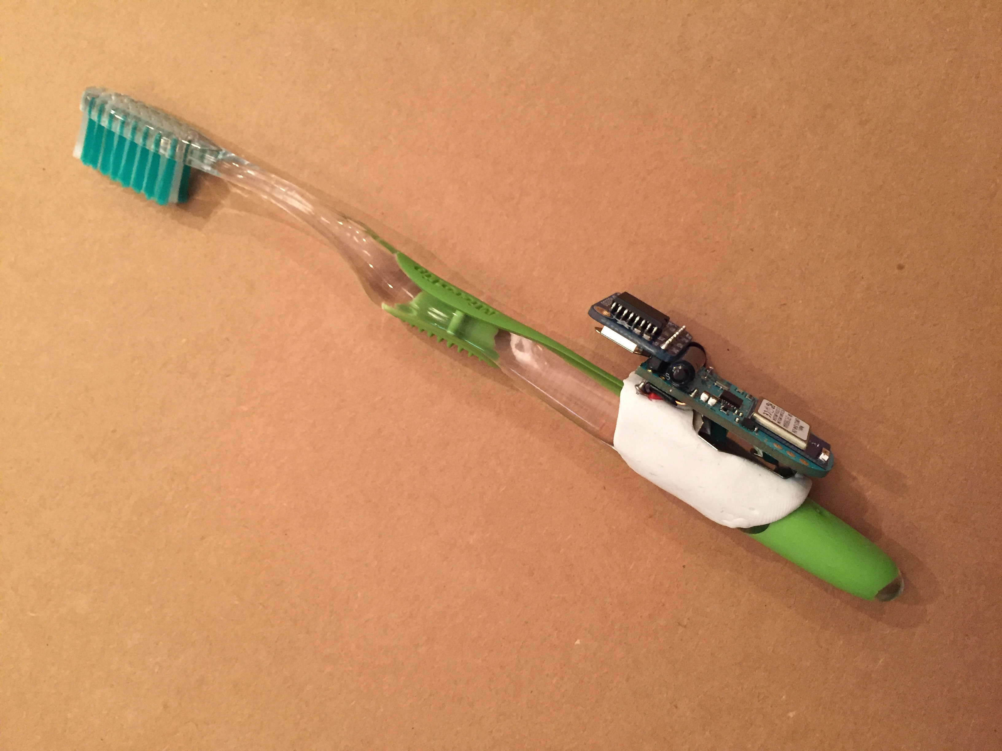

Slide 7
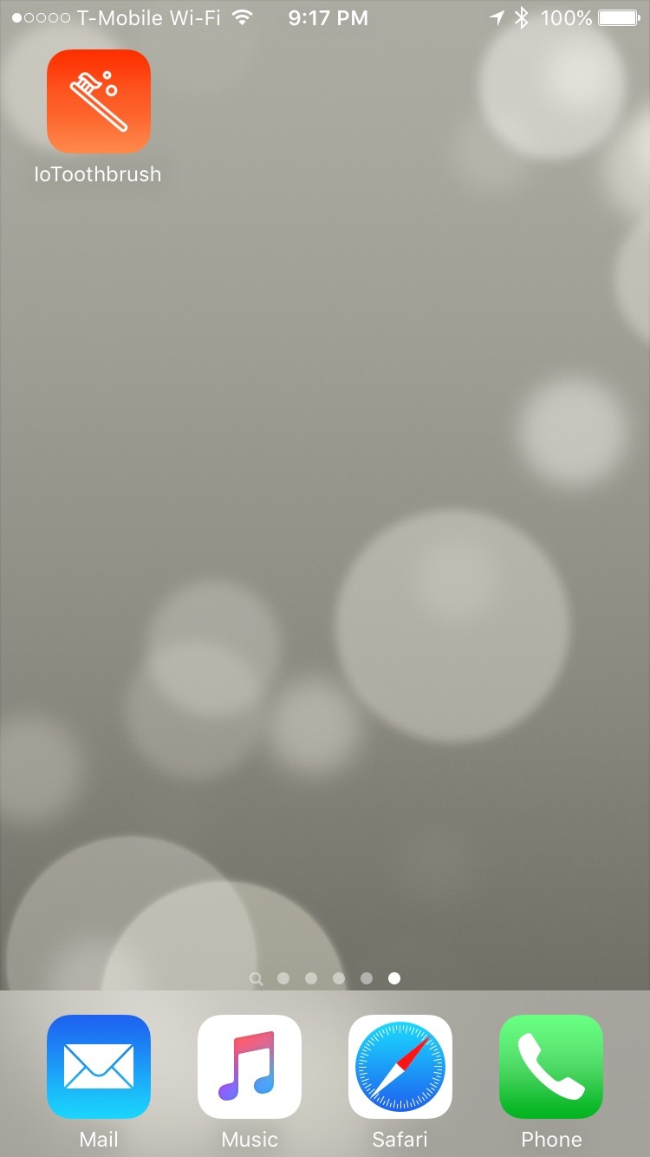

Slide 8
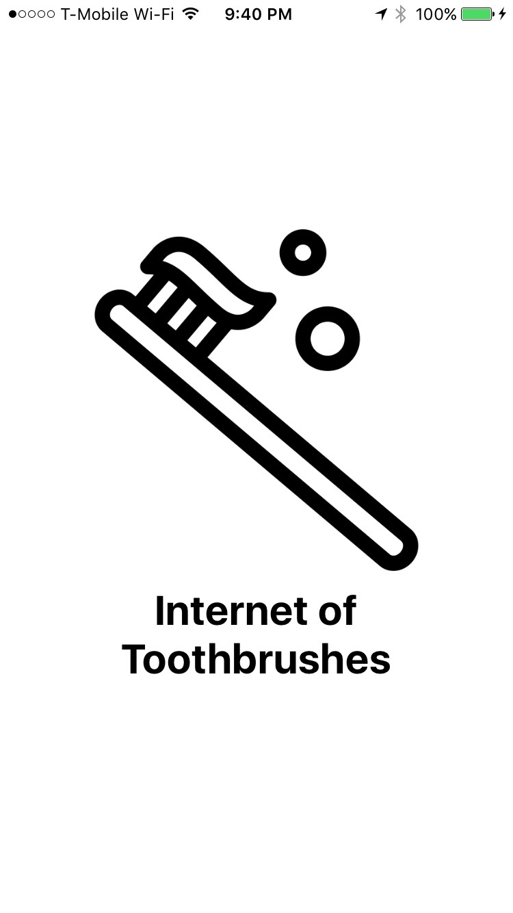

Slide 9
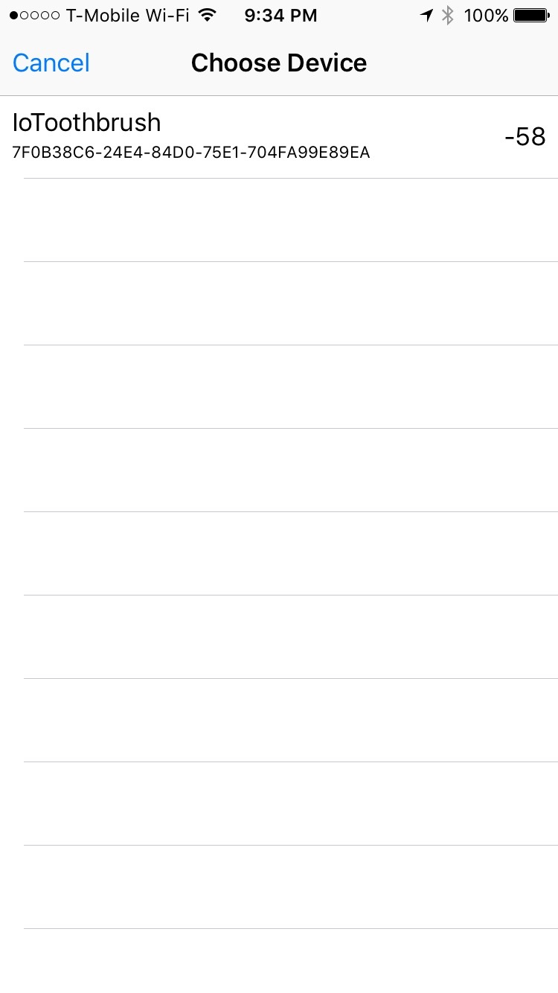

Slide 10
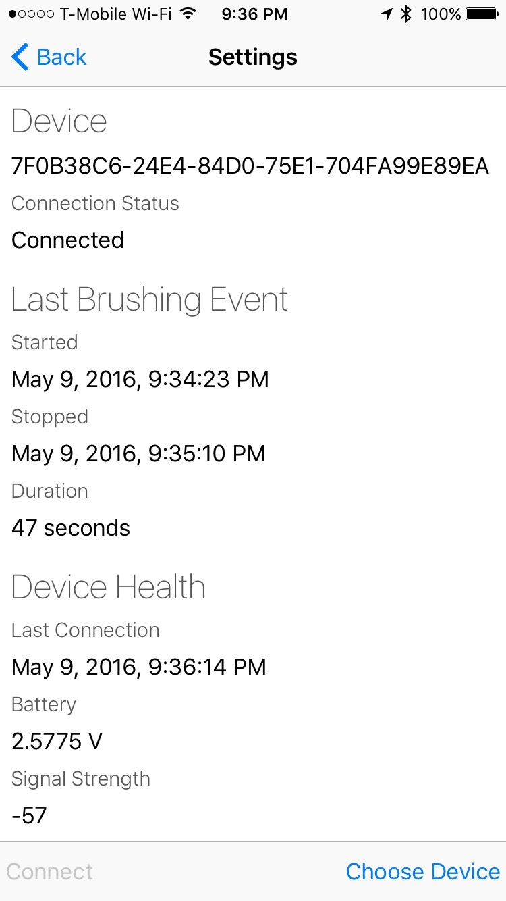

Slide 11
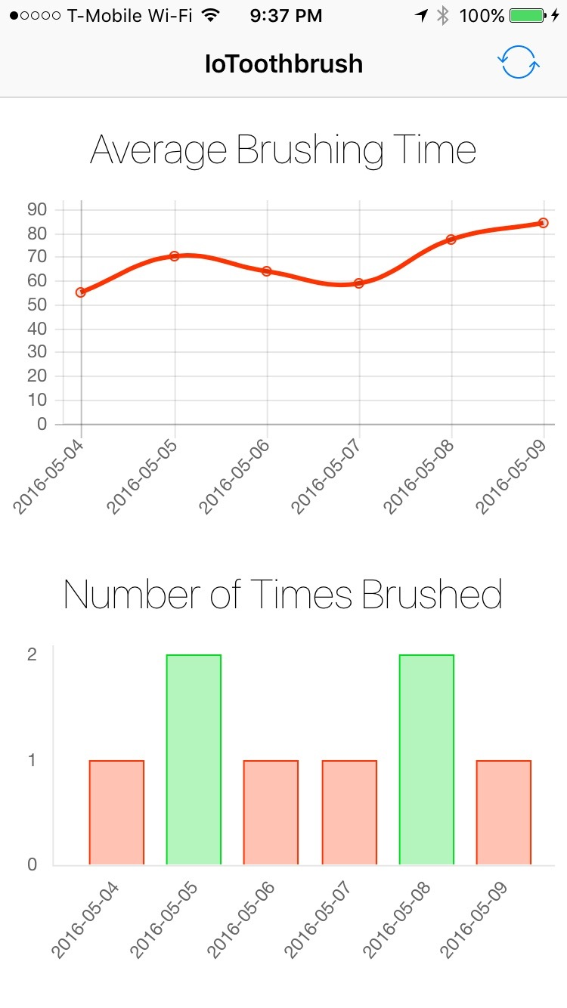

Slide 12
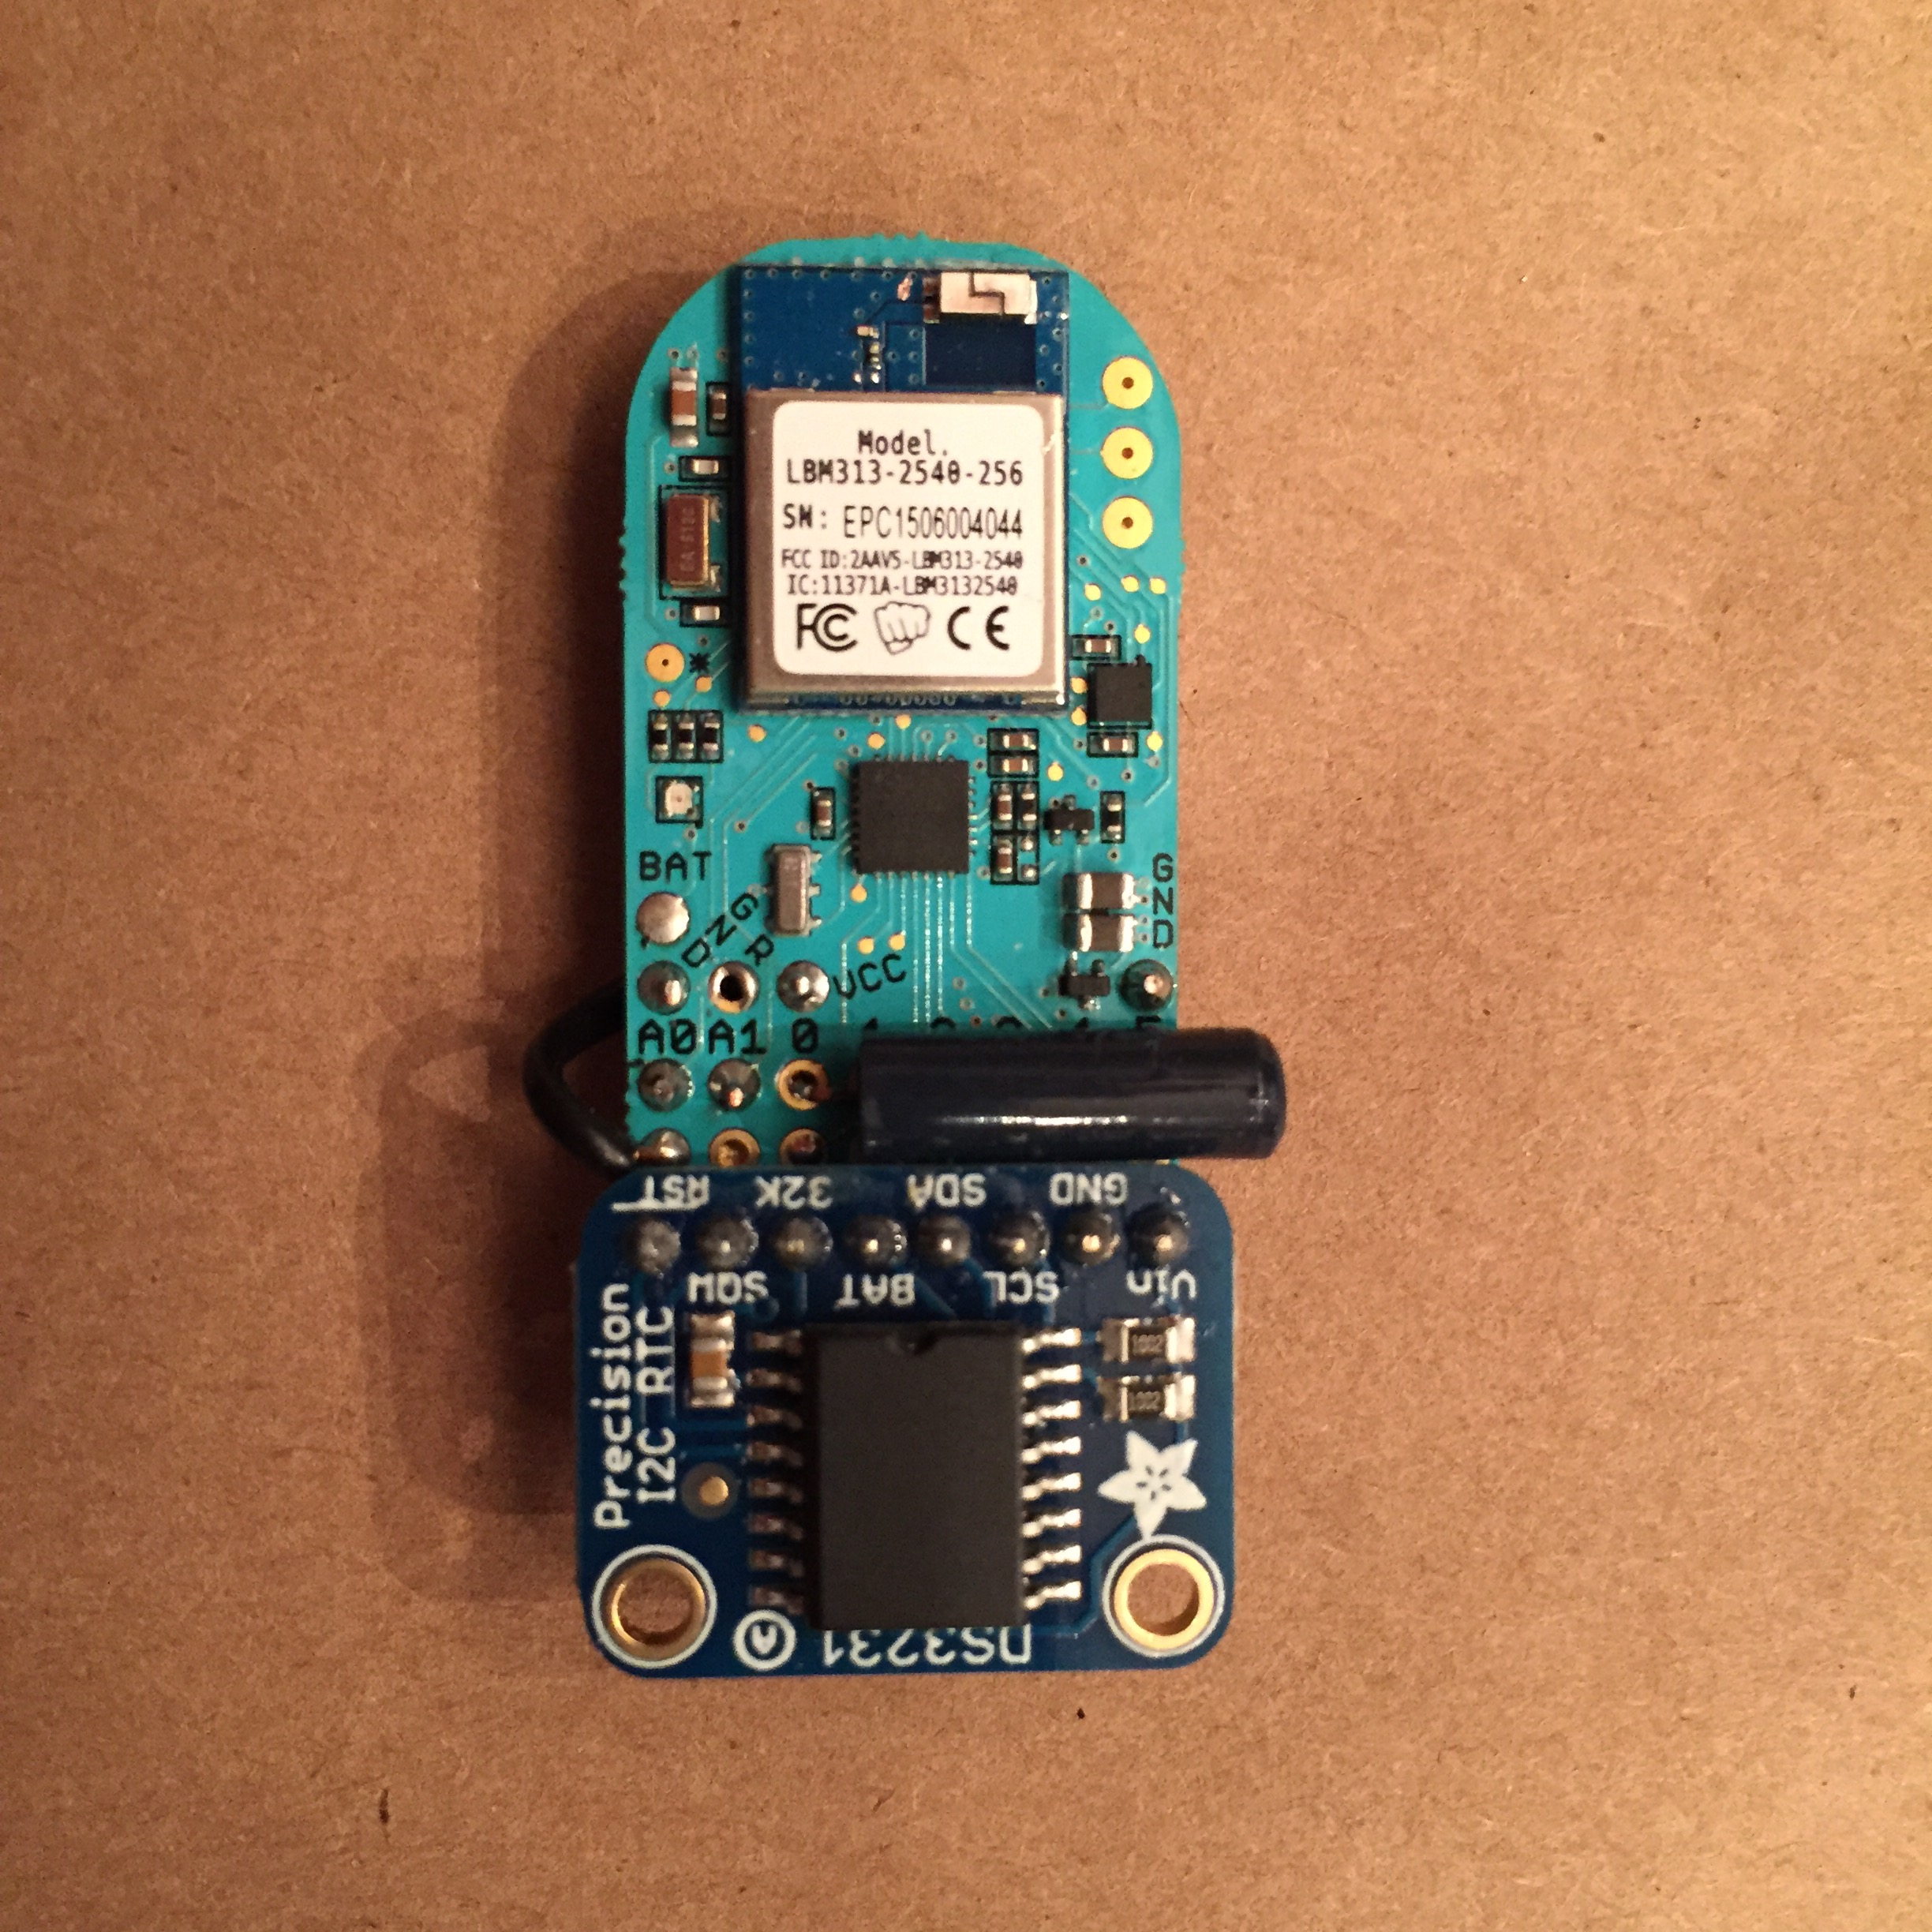

Slide 13
Features
Attaches to any toothbrush and reusable
Deep sleep until device is picked up
Fast vibration sensor sends hardware wake up interrupt
Tracks time spent brushing teeth
Uses a real time clock for accurate event timing
Phone application to read the brushing data
Bluetooth connection will also wake from deep sleep
LED Indicator
Green: Tracking brushing
Blue: Connected to phone
Data stored in scalable backend
Graphs summarize daily toothbrushing to reinforce healthy habits

Slide 14
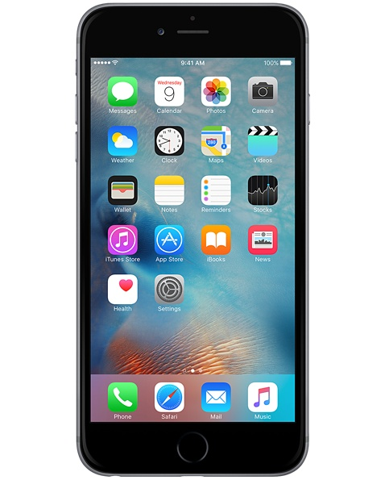
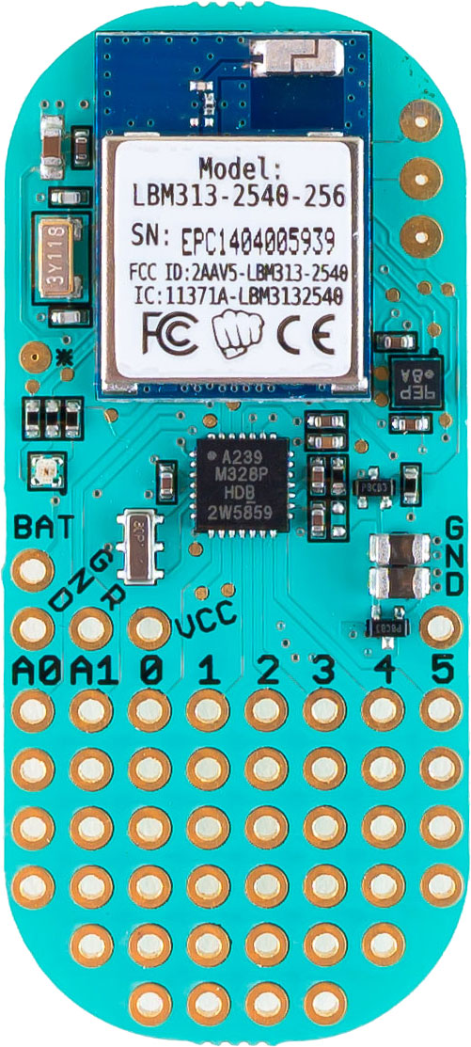

Architecture
HTTP POST Brushing Events
Bluetooth Low Energy
GATT Serial
HTTP GET Chart Summary
Hardware
PunchThrough Design LightBlue Bean
Bluetooth Low Energy Stack
Arduino
Accelerometer
Status LED
DS3231 Real Time Clock
Fast Vibration Sensor
Sugru Moldable Glue
Firmware
Arduino Sketch
Libraries:
PinChangeInterrupt
RTCLib
Frontend
iOS Application in Swift
Libraries:
PTD Bean SDK
Alamofire
Chart.js
Icons:
The Noun Project
Backend
Amazon Web Services
API Gateway
Node.js on Lambda
DynamoDB

Slide 15
Potential Improvements
Write brushing events permanently to EEPROM until phone connects
Store brushing events on phone when data service is unavailable
Blinking LED to remind you to brush when you haven’t in some time
Phone notification when your toothbrush needs replacement
Give your toothbrush a unique name
Smarter detection of brushing activity
Better detection and rejection of false brushing events
Automatically initiate sync when nearby (iBeacon?)
Remove extraneous circuit board, encase in plastic for waterproofing

